Slide 1
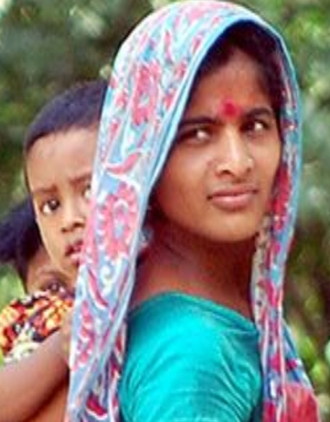
Building resilience & opportunity: Better livelihoods
for the
21st century
Emerging ideas for the World Bank’s 2012 - 2022
Social Protection and Labor Strategy
For Consultation

Slide 2
Why Social Protection?
Social protection and labor policies and programs are critical to build resilience and opportunity for individuals and societies
Crisis response
Risk mitigation
Poverty alleviation
Economic growth

Slide 3
The Centrality of Social Protection: A Recurrent Theme
“Although the current crisis has proved to be [hard] to remedy, it has taught us that ... while the policy mix will vary according to each country's particular circumstances, social protection needs to be at its centre.”
1998
Joseph Stiglitz
“The crisis lends new urgency to measures advocated in the original Growth Report, which argued that [for long-term growth] policy makers should endeavor to protect people, even as they resist calls to protect industries, firms, or jobs… The exact form of these [social protection measures] must vary from country to country.”
2010
Growth Commission

Slide 4
Global challenges

Slide 5
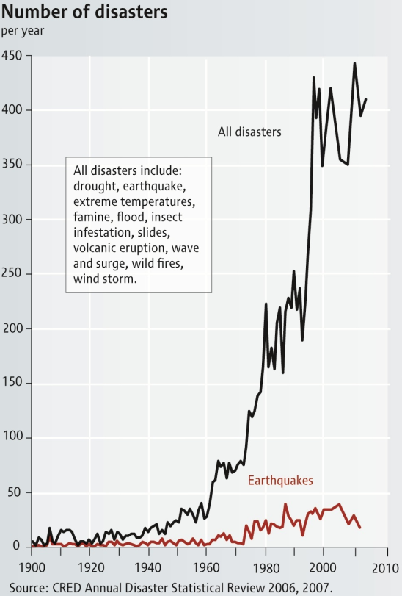
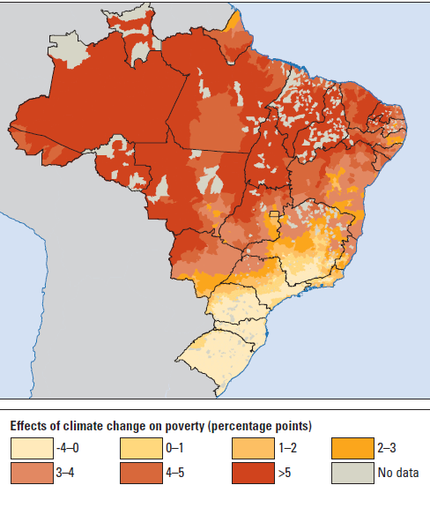
Global Challenge #1: Increasing Risk: Climatic, Economic, Social → heightened by globalization-interdependency
Increasing frequency of disasters …
… that will hurt the poorest disproportionately
Poorest regions
BRAZIL
Projection for 2050
Source: World Bank, World Development Report 2010
Notes:
…can deepen poverty, heighten inequality

Slide 6
Global Challenge #2: Demographics: aging, youth bulge, urbanization, migration
Source: Hayashi and others (2009)

Slide 7
Global Challenge #3: Operational challenges in Social Protection and Labor approaches
Low Coverage, particularly in low-income countries
Large variance across and within regions
Social assistance + other
Fragmented Programs
Only social assistance
Only social insurance
Example: where cash transfer programs in Sub-Saharan Africa are based
No transfer
(% of households that receive)

Slide 8
Global Challenge #4: Knowledge and Results
Gaps in four areas:
Knowing what exists
Data availability on programs is uneven
Understanding results
Ongoing programs are seldom carefully
evaluated
Understanding contexts
Social contract and preferences, political economy and administrative capacities are not always understood
Transmitting good practices
Global transfers of knowledge – North-South and South-South need to be increased

Slide 9
The role of social protection and labor

Slide 10
The “3P” framework:
A multi-dimensional approach
Prevention
Promotion
Providing SECURITY: Insuring against risk
Promoting OPPORTUNITY: Improving human capital, labor markets and productivity
Protection
Enhancing EQUITY: Alleviating poverty and destitution
10

Slide 11
The “3P” framework: Typical tools to address the “3P”s
Promotion
Protection
Prevention
SECURITY -- Risk management
Crop and weather insurance
Health insurance
Remittances
Pensions
Public works
Unemployment and disability insurance
OPPORTUNITY – Building human capital, productivity
Nutrition services
Agricultural extension
Microcredit
Skills training
Conditional cash transfers
Labor market programs
EQUITY -- Poverty alleviation
Charitable payments
Family and community transfers
Conditional and unconditional cash transfers
In-kind transfers
Notes:
Note: The items in white are not public SP and labor programs, but are also critical instruments to reach the 3P objectives
And the tools can be public or private
Two other points to make here:
First, individuals (except for the structurally poor) typically would move among needing the three types of measures along their lifetime
Second, therefore this calls for an overall “system” where this movement would actually be coordinated, rather than the fragmentation that exists in many countries today, with individuals and households either falling through the cracks, or being covered by multiple uncoordinated programs

Slide 12
The “3P” framework: Results in Brazil and Ethiopia
BRAZIL: Bolsa Familia
Unconditional cash transfers for elderly and most vulnerable
ETHIOPIA: Productive Safety Nets
Cash transfers to create jobs
Conditional cash transfers (CCTs) for health and education
Poverty fell by 2/3 over 6 years
Increased livestock holdings by 14%
Beneficiaries affected by drought had 30% more food
Reached 12 million families (70% of households living in extreme poverty)
Inequality reduced dramatically
Covered 7.6 million people (10% of population)
Increased school attendance, child vaccinations, pre-natal care
CCT (based on public works)
Unconditional cash transfers for targeted labor-scarce households
Contributed to asset creation and improved environmental quality
The Program
The Program
Results
Results

Slide 13
A life-cycle portfolio of programs to build resilience and opportunity
Protection: Social pensions
Prevention: Old-age pensions, disability insurance
Pregnancy, Early childhood
School age
Youth
Working age
Old age
Promotion: Nutrition/ECD, CCTs for pre-school, health
Protection: OVC programs, child allowances
Promotion: CCTs for (girls’) education
Protection: Child allowances, school feeding
Promotion: Employment services, entrepreneurship, training and skills
Protection: Cash and in-kind transfers, public works programs
Prevention: Unemployment, disability insurance
Promotion: Youth employment programs, skills training

Slide 14
Emerging areas of focus for new World Bank Social Protection and Labor strategy
Global Gaps | Areas of focus
Fragmentation | Build appropriate, country-specific, social protection systems
Coverage | Expand coverage, especially in low-income countries and fragile states
Weak link to productivity | Promote links to human capital, skills and labor market insertion
Knowledge | Expand investment in results and knowledge

Slide 15
Systems: Better social protection for the future
Goal: Policy coordination to ensure efficiency, equity and incentive compatibility
Better capacity contexts
Well-functioning programs with aligned incentives and clear institutional roles
Goal: Improving efficiency and efficacy of each program, improving coordination across programs
Emerging capacity contexts
Existing systems often fragmented, with limited capacity to coordinate
Goal: Building the “nuts and bolts” sub-systems to provide one or more 3P functions
Low capacity contexts
Few or no functional formal 3P programs
15

Slide 16
Moving to systems yields multiple benefits
Equity
Diversification and adaptation
Smarter financing arrangements
Economies of scale
Incentives
Broader coverage of population and services
Notes:
Equity. All individuals have the same rights and obligations.
Diversification. Most individuals face all risks and market failures that SP schemes address simultaneously and therefore integrated instruments are likely to perform better – and adapt better to macro shocks.
Financing arrangements can be better designed if they apply to a system as opposed to independent schemes.
Economies of scale can be generated by integrating administrative and IT systems given common business processes.
Incentives. Better integrated programs and schemes can generate better incentives and have fewer unintended consequence on behaviors.
Coverage. It is more efficient to have an integrated strategy to expand the coverage of different programs, than uncoordinated initiatives.

Slide 17
We want to hear from you!
For information and feedback:
www.worldbank.org/spstrategy

Slide 18
World Bank and Social Protection: Growing demand, demonstrated results
Strong pro-cyclical lending…
…and increasing global experience
Source: Business Warehouse

